Slide 1



SMART INDIA HACKATHON 2026
TITLE PAGE
Problem Statement ID - SIH26142
Problem Statement -
Theme - Space Technology
PS Category -Software
Team Name -TRUSTIANS
Team ID
Deep Learning Based Super Resolution Mapping (SRM) from Medium Resolution Satellite Imageries

Slide 2

IDEA TITLE
Detailed explanation of the Proposed solution
How it addresses the problem
Innovation and Uniqueness of the solution
You want to map Sentinel-2 10m multispectral data to a target resolution of 2.5m super-resolution outputs
Adopt the Hybrid CNN + Swin Transformer framework to learn local and global spatial dependencies
For B02, B03, B04 and B08 (Blue, Green, Red and NIR) bands. Native 10m bands of the Sentinel-2 satellites. Copernicus Data Space Documentation
On the other hand, free satellite data with a coarser spatial resolution (10m/pixel) is no longer suitable for precise agriculture, urban, or disaster analysis
Many commercial imagery providers do not offer higher fidelity data at any price point
.
Upscaled via AI provides usable high-res without the need for paid imagery.
4× spatial improvement; 2.5m target from 10m Sentinel-2 imagery output
A hybrid of CNN + Swin transformer to achieve higher performance than standard super-resolution techniques
Benchmark-based validation: PSNR, SSIM, SAM and ERGAS (all well-known remote-sensing metrics for up-scaling frameworks)

Slide 3
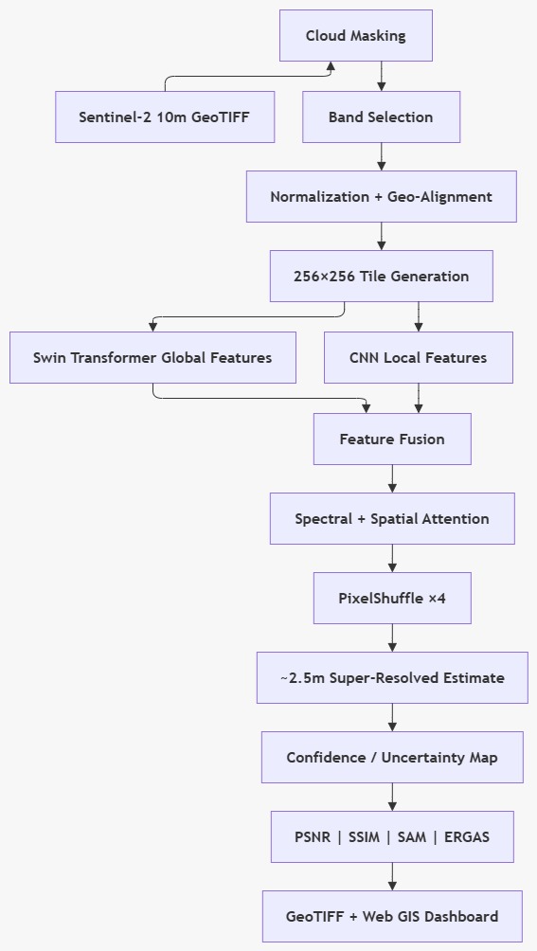
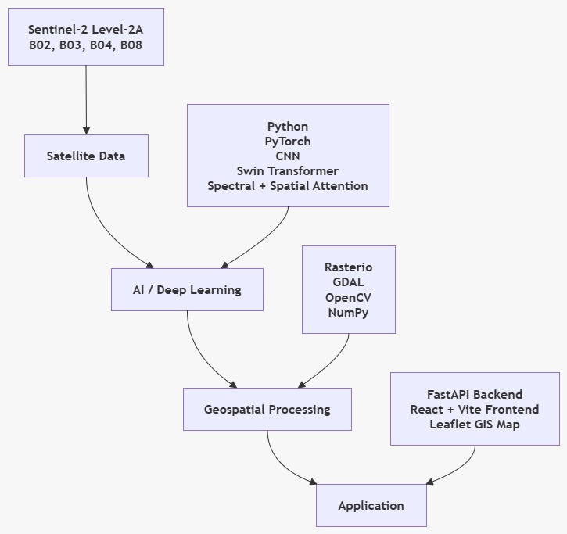
TECHNICAL APPROACH

Slide 4
FEASIBILITY AND VIABILITY
Potential challenges :
SR is ill-posed — what you reconstruct does not have to be ground truth
Domain gap between training data for cross-sensor and actual Sentinel-2
The hybrid architecture of CNN + Transformer is heavy for large satellite scenes
Cost feasibility
Sentinel-2 open data + open-source DL frameworks — zero sensor cost
Implementation feasibility
Using pre trained CNN / Transformer backbones + transfer learning allows us to train our model using fewer time & GPU.
Data feasibility
Public paired datasets (WorldStrat, PlanetScope, NAIP) already exist for training and validation
Operational risk
Accuracy dips under cloud cover, dense terrain, and seasonal spectral shifts
Overcoming challenges :
produce uncertainty maps at pixel level to detect aWe reas with low confidence
Degradation Aware Domain Adaptation To Bridge The Sensor Gap
Faster inference through knowledge distillation to a lightweight model

Slide 5

IMPACT AND BENEFITS
Agriculture
Urban
Disaster
Forest / Land cover
Clearer field boundaries
Crop monitoring
Irrigation pattern analysis
Built-up area change
Road/infrastructure patterns
Urban expansion
Shoreline change
Coastal erosion
Water-edge monitoring
Forest boundary analysis
Land-cover change
Deforestation monitoring
Economic benefits :
Lowers reliance on expensive higher-resolution satellite imagery
Uses free Sentinel-2 data as opposed to novel sensors
Reduces manual field survey effort
Environmental and social benefits :
Better water-body and land-use monitoring
Supports informed, timely public decision-making
Open Data Driven — Zero additional hardware footprint

Slide 6
RESEARCH AND REFERENCES
Innovation
Research / Existing Work
Existing: CNN / GAN / Transformer / Diffusion SR
Large-scale scalability: accuracy + spectral/geospatial fidelity + uncertainty
Kyle Polovitz · Your training was up to October 2023.
2.S2GAN (2020)
1.DSen-2 (2018)
First GAN for Sentinel-2, 20/60 m→10m
20/60 m→10m, 50% better RMSE
Ref: sciencedirect.com/science/article/pii/S0924271618302636
Ref: ieeexplore.ieee.org/document/9105165
3.Transformer by Sharifi & Safari 2025
4.LDSR-S2 - Donike et al. (2025)
Key References
2.5m, Europe-scale, pixel-wise uncertainty
Copernicus Sentinel-2 L2A
WorldStrat — NeurIPS 2022
SwinIR — Liang et al., 2021
PSNR 33.52dB, beat ResNet/Swin/ViT
Ref:
doi.org/10.1109/JSTARS.2025.3542220
Ref:
doi.org/10.1109/JSTARS.2025.3526260

